Slide 1
Operating Jurisdictions (OJ) and Total User Based Alarming (TUBA)

Slide 2
Operating Jurisdictions
The XA/21 system may be partitioned into up to 128 unique Access Areas and up to 64 unique Zones. A set of one more more Access Areas is combined with a set of one or more Zones to form a AOR or Area of Responsibility (AOR). Every point in the system is assigned a single AOR. Every Autocad display may optionally be assigned an AOR. One or more AORs may be grouped together to form a AOR Assignment. Each user in the system is assigned a AOR Assignment.
At operator login, the user is presented with a list of AORs defined in the user’s AOR Assignment. The user may then select one or more of these AORs to use for that login session. The selected AORs are then combined to form the user’s View AOR.
Each AOR within the user’s AOR Assignment definition may optionally be designated as a Control AOR. At user login, any selected AORs that are so designated are combined to form a second AOR for that user, called the Control AOR.
Two AORs are said to intersect if and only if they share at least one common Zone and at least one common Access Area.
For alarms and events, a user only sees those alarms/events that have AORs that intersect with the user’s View AOR.
If a user’s View AOR intersects with a point’s AOR, the user may select the point. If the user’s Control AOR also intersects with the point’s AOR, then the point select interface is displayed in Control Mode, allowing the user to perform data entry, issue controls, create tags, etc. If the user’s Control AOR does not intersect with the point’s AOR, then the point select interface is displayed in View Mode, which prohibits the user for performing data entry and control operations on the point.C102-3364 XA/21* System Overview 7–13 date modified: March 24, 2006 1.0a date printed: March 24, 2006
Likewise, if a user’s View AOR intersects with a display’s AOR, the user may call up the display. If the user’s Control AOR also intersects with the display’s AOR, then the viewport shows the display in Control Mode. In this mode, all points on the display have the potential to be selected in Control Mode (see above), and page data entry is allowed on the display. If the user’s Control AOR does not intersect with the display’s AOR, then the viewport shows the display in View Mode. In this mode, all points on the display may only be selected in View Mode, and page data entry is disallowed on the display. If a display does not have an AOR, then no AOR checking is performed, and the viewport shows the display in Control Mode.

Slide 3
User Name
WEIGANDK
HASSELRP
LAVORIRP
Populated with list of users provided by GCC/GridOps and PSC (use wxp ids)
User Login
Lighthipe Switching Center AOR Assignment
LIG - ALAMITOS
LIG - CENTER
LIG - DEL AMO
LIG - HINSON
LIG - LAGUNA BELL
LIG - LIGHTHIPE
AORAsgnRefName
Each Assignment will initially be aligned with the Switching Centers, and GCC and have sets of the AORs under their jurisdiction defined within each assignement
Populate all point database with a cross reference table of Station and AOR.
Reference Name
AOR Assignment
Status Point
AORRefName
AORRefName
Analog Point
Create AOR by Switching Center that contains their A Bank Systems, and AOR for GCC with Switching Centers and GCC Access Areas.
AOR Ref Names
CON - INYO SCE
DEV - DEVERS
DEV - EAGLE MT.
…
LIG - ALAMITOS
LIG - CENTER
LIG - DEL AMO etc…
Reference Name
AOR
Analog Point
AccAreaAsgnRefName
AccZoneAsgnRefName
Reference Name
Reference Name
Populate with 44 A Bank Systems, and groups of area assignment for each Switching Centers.
Initially Align this one to one with Access Zone Table
Access Area Assignment
Access Zone Assignment
Reference Name
Reference Name
Populate with 44 A Bank Systems, and other Access Area such as Foreign Utilities, DMC and Misc. for GCC.
Description
Description
Access Area
Access Zone
Each Switching Center would be a Zone, follow by GCC, PSC Maintenance, and Substation Training.

Slide 4
Total User Based Alarming
The XA/21 system provides the ability to define up to four Dispatcher Operating Groups (i.e. Transmission/Dispatch, Grid, etc) . Each user is then assigned to one and only one of those dispatcher operating group in the XA/21 database. The user’s operating group determines how alarms and events are presented to the user.
Each point in the system is assigned an alarm profile. An alarm profile contains a set of default alarm classes for each alarmable condition on the point. The profile also contains an optional set of alarm classes for each defined dispatcher operating group. This provides the ability for the system to treat a single event on a point differently for each defined operating group and therefore present that alarm differently to each dispatcher operating group (i.e. different alarm priority and/or audible per group).
An alarm on a point is now said to be completely acknowledged on a dispatcher operating group basis. If all AORs within a given operating group are acknowledged, then the alarm is considered fully acknowledged for that group and will no longer flash on one-line displays for users within that group. Alarm deletion works in the same manner.

Slide 5
DOG1 – Populate with Default Alarm
DOG2 – Initially populate with Default Alarm in the database SCE will provide additional info
DOC3 – populate with profile 15 (event only) exception stations with other profile will be provided
Status Point
Analog Point
Accum Point
DOG1Ref
DOG3Ref
DOG1Ref
DOG3Ref
DOG1Ref
DOG3Ref
DOG2Ref
DOG4Ref
DOG2Ref
DOG4Ref
DOG2Ref
DOG4Ref
Populate with 16 profile (one for each alarm class) Status Point Alarm Profile 1-16
Populate with 16 profile (one for each alarm class) Analog Point Alarm Profile 1-16
Populate with 16 profile (one for each alarm class) Accum Point Alarm Profile 1-16
Profile Number
Profile Number
Profile Number
Status Point Alarm Profile
Analog Point Alarm Profile
Accum Point Alarm Profile
Populated with list of users provided by GCC/GridOps and PSC (use wxp id)
Weigand – DOG2
Hasselman – DOG1
Lavorin – DOG1 …
User Login
DisOpGrp
EntryNumber (DOG number)
Populate with
GRIDOPS – Grid Operations
GCC – Grid Control Center
PSCMAINT – PSC Maintenance
Not used
Dispatcher Operator Group
AORAsgnRefName

Slide 6
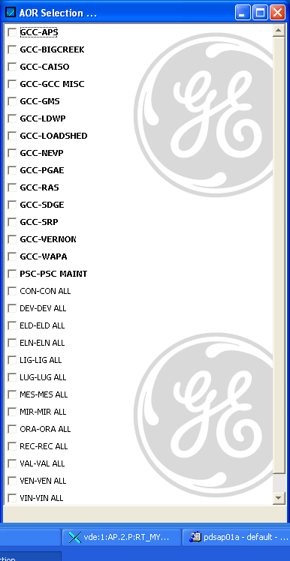
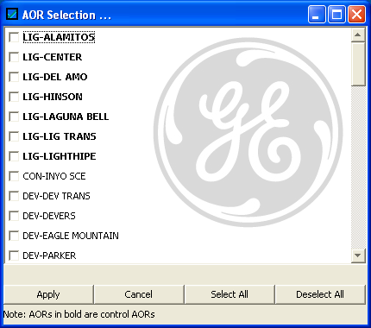
LIG AOR Selection
GCC AOR Selection

